Slide 1








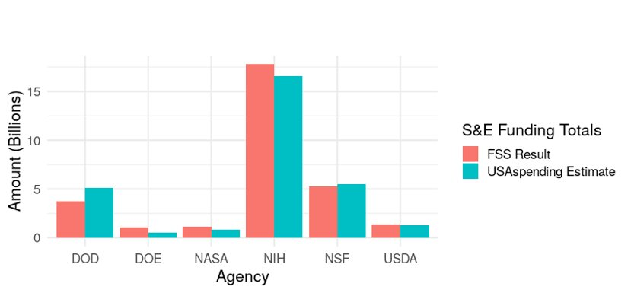
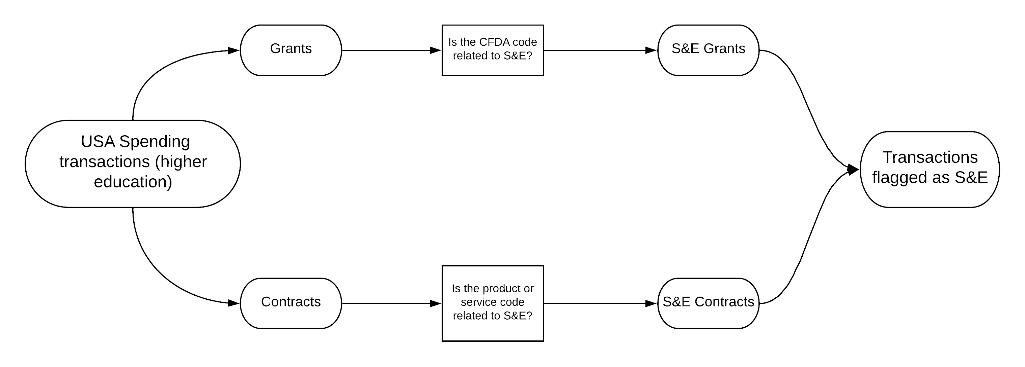

Research Question
Can we estimate how much the government spends on research and development (R&D) based entirely on publicly available administrative spending data?
The Six Primary Funders of R&D:
A Feasibility Study to Measure
Public Funding of R&D
Sean Pietrowicz, Alyssa Fowers, Joel Thurston, Samantha Cohen, Stephanie Shipp
Biocomplexity Institute, University of Virginia
What are R&D and S&E?
Research and Development (R&D):
Basic and applied research and technological developments
Excluding R&D plant for now
Science and Engineering (S&E):
Scientific activity including R&D
Also training, conferences, career pipelines, teaching and fellowships
SOCIAL AND DECISION ANALYTICS DIVISION
Data Source: The Federal Support Survey (FSS)
The Survey of Federal Science and Engineering Support to Universities, Colleges, and Nonprofit Institutions (FSS) is run by the NCSES
Collects information yearly to determine R&D and S&E funding from universities and nonprofit organizations.
Latest survey: 2016 XX
Census
Research and Development: Basic & applied research and technological developments
Science and Engineering (S&E): Scientific activity, including R&D, as well as training, conferences, career pipelines, teaching, fellowships, and facilities for conducting research (R&D plant).
R&D Sanity Check: Federal Reporter
NIH-run public database of 5 of 6 major funding agencies
Entirely R&D funds
Based on yearly awards, unlike our benchmark, from XX to 2018
Linked to USA Spending via (heavily cleaned) FAINs
Federal Reporter identified only an additional 0.01% of grants as S&E.
Even with limited scope, the two databases are in agreement on XX% of cases
Found in Federal Reporter
Yes No
Data Discovery: Screening
Data Source: USA Spending
USA Spending was chosen due to its wide coverage of the six main R&D funding agencies and field alignment with FSS.
Publicly available database of government spending maintained by the NIH XX.
Separate treatment of Grants and Contracts
XX records in Fiscal Year 2016
Each record is a payment toward some award.
Not limited to R&D or S&E.
XX​
Identified as S&E in USA Spending
Yes No
XX​
Basic information
Ease of obtaining/ interpreting data
Matching to survey data
Enabling detailed analysis
XX
XX
Working with Federal Funding Databases: Practical Considerations
Next Steps
Default Text Title
Default text
Data Discovery: Agency Coverage
Energy
Defense
Place holder: Mosaics and Bar plot
Source
USA Spending
Federal Reporter
Current Research Information System
Conservation Innovation Grants project list
NIH Project Exporter
Conservation Innovation Grants All Project List
NSF Award Search
Office of Science Awards
DOE Public Access Gateway for Energy & Science (PAGES)
ARPA-E Projects
Is It Feasible to Estimate R&D with Public Data?
Yes. Using project funding indicators in USA Spending, we produced estimates of S&E funding similar to those in the FSS.
References - Franklin Gothic Demi - 24
Reference Text - Franklin Gothic Book - 18
Determining S&E funding:
Separate
Screen
Total
1
Figure #1
Figure #2
2

Slide 2
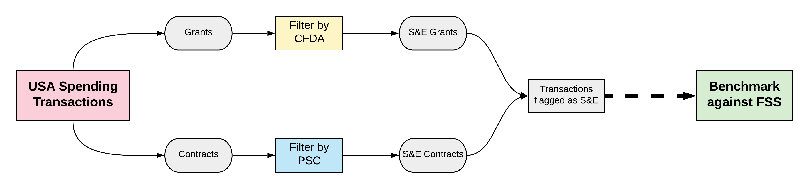
A Feasibility Study to Measure
Public Funding of R&D
Sean Pietrowicz, Alyssa Fowers, Joel Thurston, Samantha Cohen, Stephanie Shipp
Biocomplexity Institute, University of Virginia
SOCIAL AND DECISION ANALYTICS DIVISION
Research Question:
Can we estimate how much the government spends on research and development (R&D) based entirely on publicly available administrative spending data?
Determining S&E funding in USA Spending:
2
1
4
3
1
2
4
Default Text Title
Default text
USA Spending
Publicly available database of government spending maintained by the NIH XX.
Separate treatment of Grants and Contracts
XX records in Fiscal Year 2016; Each record is a payment toward some award.
Not limited to R&D or S&E.
CFDA Codes
The Federal Support Survey (FSS)
The Survey of Federal Science and Engineering Support to Universities, Colleges, and Nonprofit Institutions (FSS) is run by the NCSES
Yearly census of R&D and S&E funding; last survey in 2016 XX
Research and Development: Basic & applied research and technological developments
Science and Engineering (S&E): Scientific activity, including R&D, as well as training, conferences, career pipelines, teaching, fellowships, and facilities for conducting research (R&D plant).
3
Product & Service Codes (PSC)
Sanity Check: Federal Reporter
NIH-run public database of 5 of 6 major funding agencies of R&D
Based on yearly new awards, not transactions
Linked to USA Spending via (heavily cleaned) FAINs
Federal Reporter identified only an additional 0.01% of grants as S&E.
Even with limited scope, the two databases are in agreement on XX% of cases
Found in Federal Reporter
Yes No
XX​
Identified as S&E in USA Spending
Yes No
XX​
XX
XX
Is It Feasible to Estimate R&D with Public Data?
Yes. Using project funding indicators in USA Spending, we produced estimates of S&E funding similar to those in the FSS.
Future Work, Additional Considerations:
XX

Slide 3
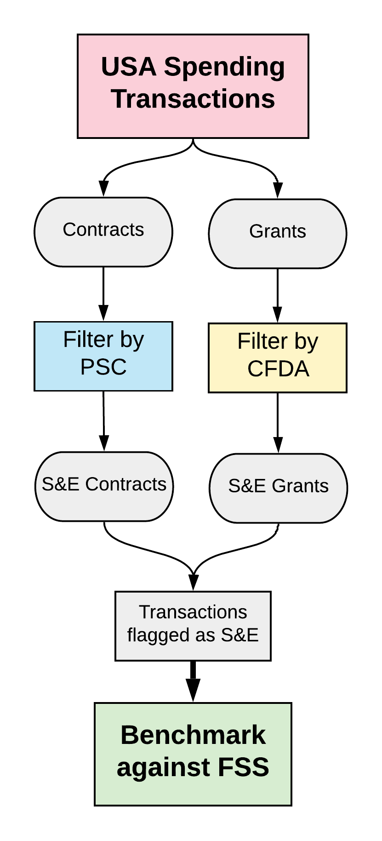
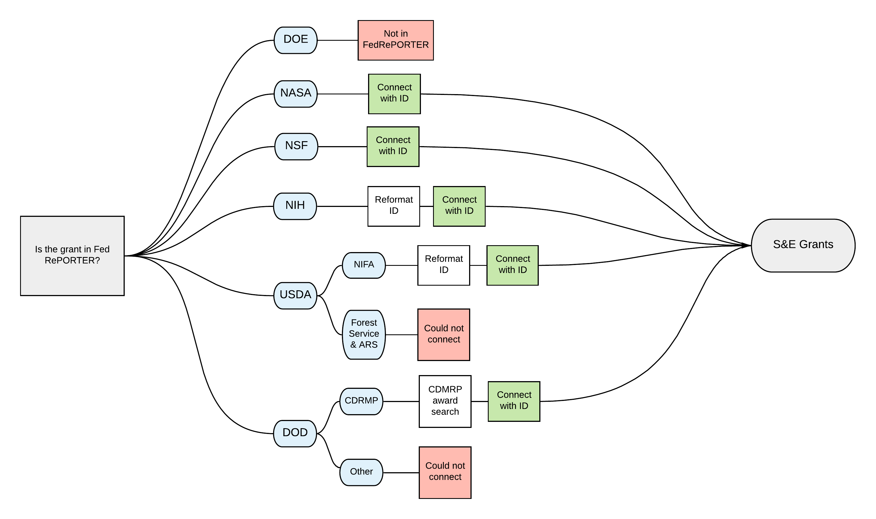
A Feasibility Study to Measure
Public Funding of R&D
Sean Pietrowicz, Alyssa Fowers, Joel Thurston, Samantha Cohen, Stephanie Shipp
Biocomplexity Institute, University of Virginia
SOCIAL AND DECISION ANALYTICS DIVISION
Research Question:
Can we estimate how much the government spends on research and development (R&D) based entirely on publicly available administrative spending data?
A yearly government census is the official method to track this information. How well can we match it when harnessing the potential of publicly available information?
What is Research and Development (R&D)?
Basic & applied research and technological developments​
Determining S&E funding in USA Spending:
What is Science and Engineering (S&E)?
Scientific activity, including R&D, as well as training, conferences, career pipelines, teaching, fellowships, and facilities for conducting research (R&D plant)
USA Spending
Publicly available database of government spending
Maintained by the Treasury Department
Separate treatment of Grants and Contracts
Each record is a payment toward some award.
Not limited to R&D or S&E.
CFDA Codes
Five digit code explains intended use of funds
Our filtering system contains a hand-picked list of S&E-only codes to screen grants
Product & Service Codes (PSC)
A tag on each transaction that classifies each contract's purpose, which enables specific screening for R&D
The Federal Support Survey (FSS)
The Survey of Federal Science and Engineering Support to Universities, Colleges, and Nonprofit Institutions (FSS) is run by the NCSES
Yearly census of R&D and S&E funding; last survey in 2016
USA Spending 2016:
174,377 grants
128,617 contracts
Found in Federal Reporter
Identified as S&E in USA Spending
 | Yes | No
Yes | 69,932 | 18,252
No | 93 | 3,759
Sanity Check: Federal Reporter
NIH-run public database of 5 of 6 major funding agencies of R&D
Based on yearly new awards, not transactions
Linked to USA Spending via (heavily cleaned) FAINs
Is It Feasible to Estimate R&D with Public Data?
Yes. Using project funding indicators in USA Spending, we produced estimates of S&E funding similar to those in the FSS.
Future Work, Additional Considerations:
Refining subtypes of S&E and R&D
Additional microdata, e.g. abstracts
Examining agency-specific databases
Identified as S&E in USA Spending
No Yes
Found in Federal Reporter
Yes No
Federal Reporter identified only an additional 0.1% of grants as S&E.
Even with limited scope, the two databases are in agreement on XX% of cases
69,932 | 19,252
93 | 3759

